Slide 1
Raising an Emotionally Intelligent Child
Competent

Slide 2
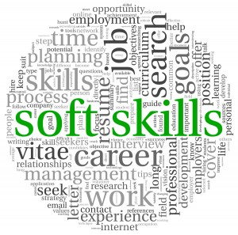
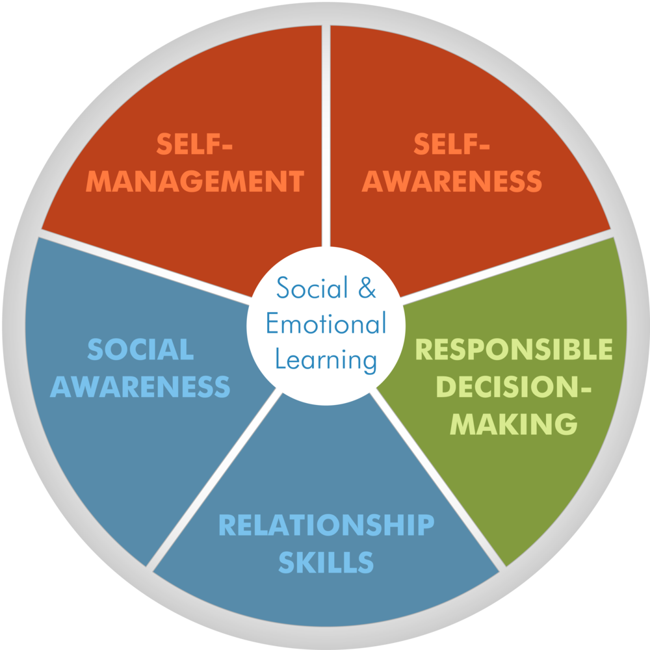
A word about terminology
Daniel Goleman published Emotional Intelligence in 1995
Nobel laureate J.J. Heckman used the terms “Soft skills” & “non-cognitive skills” in study of the economics of human potential (2000)
Today researchers and educators focus on the process of acquiring social and emotional competencies: Social and Emotional Learning (SEL)
Research shows that these skills can be learned and therefore can be taught.

Slide 3
Agenda for the Evening
What is SEL and why is it important?
Activity
Focusing on emotions: What should kids know and be able to do?
Activity
Supporting your child’s developing emotional competence
Activity
Q & A

Slide 4
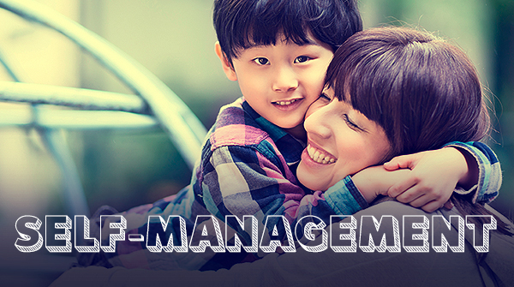
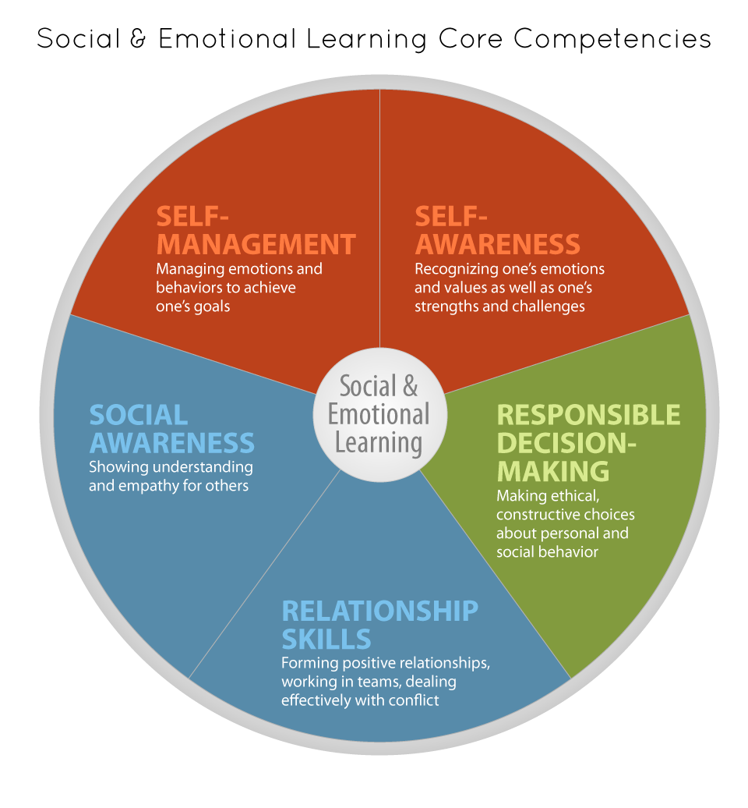
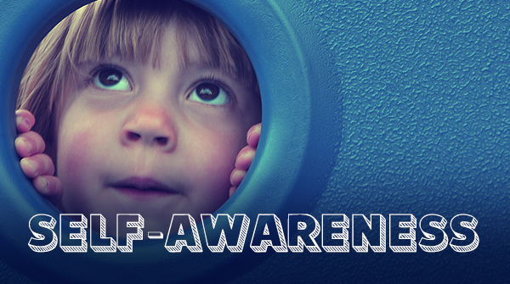
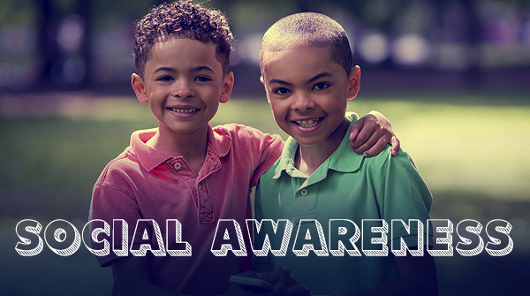
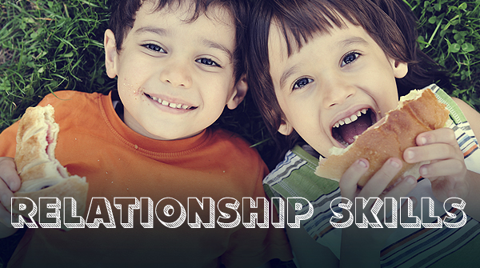
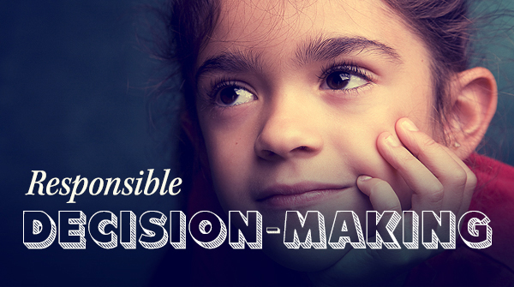
What are social-emotional competencies?
Collaborative for Academic, Social, and Emotional Learning (2012)
Notes:
So what do I mean by Social Emotional Learning?
SEL describes the acquisition of a constellation of skills including learning to express your emotions, identify and understand emotions, regulating and controlling your emotions, and finally skills that enable you to make and retain friendships including solving social problems in prosocial ways

Slide 5
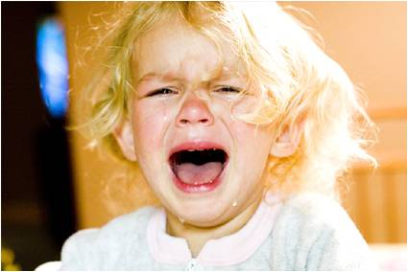
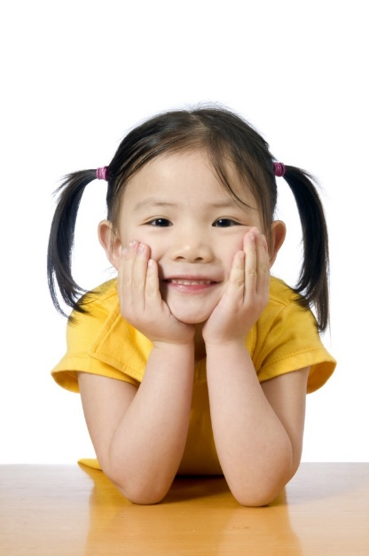
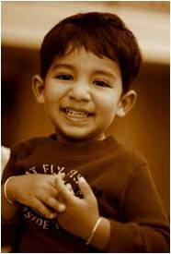
Building a Strong Foundation
True kindergarten readiness:
Positive behaviors and attitudes towards learning & school
Ability to participate in cooperative and self-directed activities
Comfort with teachers & peers
Kindergarten teachers rate students’ social and emotional skills as more important to school readiness than being able to read or hold a pencil.
Social and emotional skills now included in preschool learning standards in all 50 states.
Notes:
The new trendy phrase that has popped up in educational psychology circles is “Cradle to Career” – More than school readiness, but life readiness.
When teachers are surveyed,
Rimm-Kaufman Survey
Teachers routinely identify SE skills – such as being able to wait your turn, being able to ask for help, etc. as key for Kindergarten success – not “academic” skills like reading and counting.

Slide 6
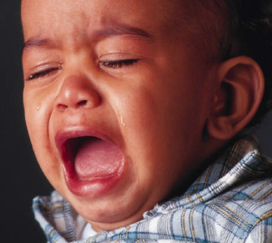
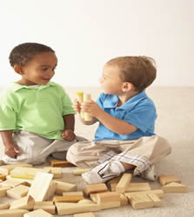
SEL is critical for social and academic success
Children without age appropriate emotional/social skills:
Participate less in class
Less accepted by classmates/teachers
Get fewer instructions/positive feedback from teachers
Like school less and less
Social-emotional competence predicts academic success in 1st grade, even after controlling for IQ and economic risk.
Notes:
Children with age appropriate emotional/social skills
Participate more in class
Are accepted by classmates/teachers
Get more instructions/positive feedback from teachers
Like school more
Aggressive/antisocial children are likely to:
Perform poorly on academic tasks
Be held back/ drop out
Struggle maintaining healthy relationships
EVEN Controlling For IQ and Family Backgrounds/SES

Slide 7
Reasonable Expectations
But what should your toddler, preschooler, kindergartener know and be able to do socially and emotionally?
Unreasonable expectations & preschool expulsion rates?
Early childhood specialists have helped educators and policy makers outline developmentally appropriate expectations to help guide parents and teachers.

Slide 8
Activity 1
The State of Illinois was first in the nation to establish SEL standards.
Three overarching goals for children’s SEL from Pre-K through 12th grade are based on the CASEL model of SEL
self-awareness and self-management; Social-awareness, positive relationships; responsible behaviors and decision-making skills.
At each grade level, the state articulates benchmarks for what children should know and be able to do.
With a partner, rank order which behaviors you would expect to see 1st (in the youngest child), 2nd , and 3rd

Slide 9
Learning Standard 30A: Identify and manage one’s emotions and behaviors
Learning Standard 30B: Recognize own uniqueness and learning qualities
Learning Standard 31.A Develop positive relationships with peers and adults.
2
3
1
Identify the emotions of characters in a storybook
Use language to express feelings when playing with or negotiating with another child
Begin to label own basic emotions with help from a parent or teacher
3
1
2
Describe him or herself (e.g., talk about self in terms of looks, gender, family, and interests)
Express likes and dislikes, including favorite foods, colors, or activities
Show confidence in abilities
3
1
2
Ask about another child’s feelings
Describe how others are feeling based on their facial expressions, gestures, and what they say
Demonstrate sympathy and caring

Slide 10
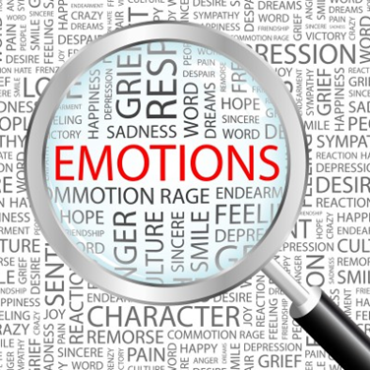
Focusing on Emotions

Slide 11
What is Emotional Competence?
Dr. Carolyn Saarni (1999) defined emotional competence as the functional capacity wherein a human can reach their goals after an emotion-eliciting encounter.
Young children (and adults!) are learning to:
Express healthy emotions
Understand their own and others’ emotions
Regulate their emotions to meet their short and long term goals
Knowledge
Regulation
Expression

Slide 12
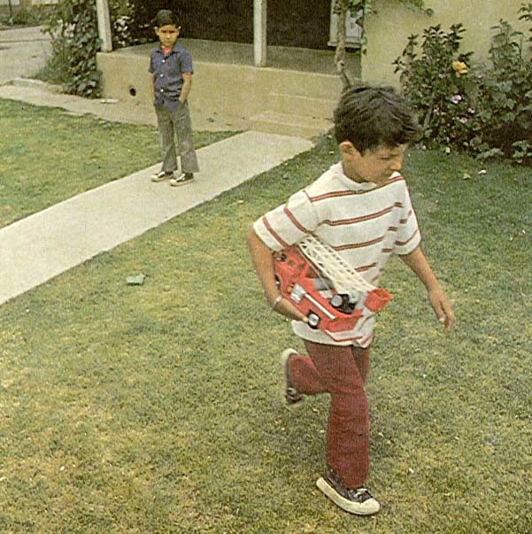
Emotion Expression
Early expression of basic emotions
Preschoolers begin to show “social” emotions
Expression of emotions tends to become stable across time. (Temperament)
Children notice these trends in their peers as well
Blended emotions
(sadness + guilt + anger)
Notes:
During the infancy-to-preschool period, children come to express all the basic emotions -- happiness, sadness, anger, fear, and surprise.
Preschoolers begin to show “social” emotions which require a sense of self and of others -- empathy, shame, guilt, contempt.
Older preschoolers also begin to show blended emotions -- for example: this boy feels sad because he can’t continue playing with his friend, but maybe also guilty because he broke the truck, and angry that his friend doesn’t want to play with him anymore.
Young children’s propensity to show these emotions tends to become stable across time, and across some situations. Perhaps you’ve noticed that some children in your classroom are just happier and more positive than others.
Children notice these trends in their peers as well – they know who will be upset more easily or who’s always fun and easy to play with.

Slide 13
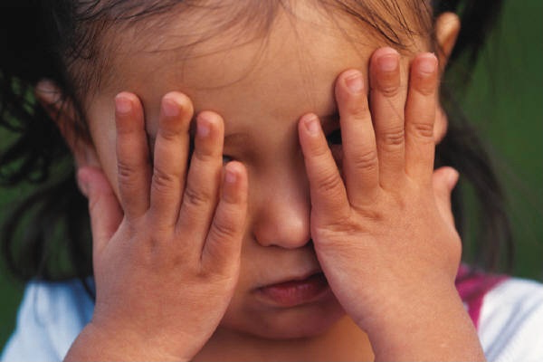
Emotion Knowledge
Emotion knowledge is quickly evolving in early childhood. Most preschool aged children can talk about
What makes them feel happy
What makes their parents angry
How their parents express emotion (“my mom slams the door”)
And what parents would do when a child was afraid (“get a night light”).
May still struggle to:
interpret complex indicators of emotions (e.g., guilt)
understand equivocal emotions
know what emotions should be expressed when
Notes:
By preschoolers most children can name and recognize expressions for most basic emotions and can identify common emotion-eliciting situations.
But figuring out what this little girl is feeling takes some thought. Preschoolers may not be able to explain that she if feeling guilty because the facial indicators of guilt are very complex. But many will be able to tell you that she feels bad in some way.
But emotion knowledge is quickly evolving in early childhood. Most young children
They can talk about what makes them feel happy
What makes their parents angry
How their parents express emotion (“my mom slams the door”)
And What parents would do when a child was afraid (“get a night light”).
Finally, they are acquiring beginnings of even more sophisticated knowledge--becoming aware of equivocal emotions. Such as knowing that some people love oatmeal even though they think it’s yucky
They’re also just beginning to understand what emotions should be expressed when. Savvy four year olds will have a better grasp on complex moral emotions and can weigh conflicting situational cues of emotions

Slide 14
Emotion Regulation
Emotional arousal is unavoidable
Individuals regulate their emotional arousal to balance internal experience with the outward social world.
Down Regulation – when emotion exceeds resources (overwhelmed) suppress experience and expression of emotion
Up Regulation – Sometimes the intensity of our emotion is not sufficient for the situation – increase positive/negative feeling.
In children, this thermostat is still under development (and in some adults too!)
Notes:
Emotional arousal is unavoidable -- we all register emotion at all times.
And as educators, most of what we see is children’s actual outward expression of emotions and behaviors. When we notice children who struggle to regulate it’s because of what they’re DOING:
Does a child react to frustration by throwing or hitting?
Is a child overly silly and disruptive
But there’s a lot more going on “under the hood” - including physiological arousal, thoughts and cognitions, the emotion they’re actually experiencing, and their actual outwardly visible behavior.
Young children are developing and fine tuning their emotion THERMOSTATs.
Just as we adjust the heat to make ourselves more comfortable at home, we also regulate our emotional arousal to balance our internal experience with the outward social world.
We do this by adjusting our emotional arousal and expression up and down.
DOWN REGULATION: Emotions can be stressful: Both Negative and Positive emotions can exceed the child's resources. When emotions become overwhelming, children’s behaviors and thought processes becoming disorganized and in order to remain engaged with their environment, children need to initiate their emotion regulation skills – maybe this includes seeking soothing help from a parent or teacher, maybe it results in them lashing out at a peer, maybe in involves telling a frustrating peer how their actions make you feel. In these instances, emotion regulation strategies aim to minimize a child’s expression and experience of an emotion.
UP REGULATION: But sometimes children need to maximize their experience or expression of an emotion. You’ve likely heard of research saying that even faking a smile can result in you feeling a little happier. Sometimes we need to up-regulate positive feelings – like putting on a brave face when your scared – whistling in the face of danger
Sometimes we also up-regulate negative emotions in order to have our needs met. Have you ever yelled at a waitress or service provider in order to have your needs met? Or maybe acted angrier than you felt with a spouse to get your way? For young children, especially those who are pre-verbal, crying is a very effective way to get help, even if you’re not really sad.
Clearly, preschoolers are already working hard at figuring out what emotions to regulate, when, and why.
We can say that young children begin to adopt means of feeling better when they experience negative emotions, and to maximize and sustain their experiences of positive emotions. But, failures to regulate properly put children in challenging social situations.
This little boy needs to figure out what to do. Is his crying helping him attain his goals? If his goal was to attract a play-mate, would YOU want to play with him?
This is where expression and regulate overlap – the emotions that children express in a preponderance can either attract or deter social partners.

Slide 15
Activity 2
In this activity, we will explore concrete examples of how your child is developing his or her emotional competencies.
To start, introduce yourself to a new partner sitting near you. Take turns sharing and listening as you go through the questions

Slide 16
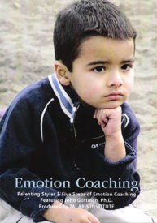
Supporting your child’s Emotional Competence

Slide 17
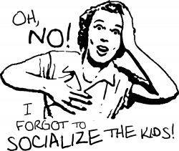
You: An Emotion Socializer
Your emotional competence and beliefs about emotions contribute significantly to your child’s social and emotional competence.
Research shows that parents and teachers serve as important socializers primarily by
Modeling
Teaching
Reacting
Notes:
Parents who are more knowledgeable about emotions may more easily scaffold children’s labeling of emotions or empathize with a child’s complex emotional experience.
Parents who are successful at regulating their emotions may respond to challenging interactions with students in more emotionally effective ways than others.
Modeling

Slide 18
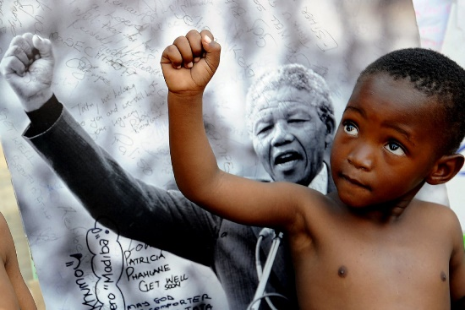
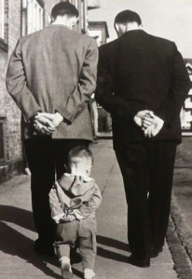
Modeling
What do children learn by watching?
By watching, children learn the display rules and expectations around expressing emotions at home and in the classroom.
How do people in your home show that they love each other?
What does your child learn about regulation from watching parents or siblings?

Slide 19
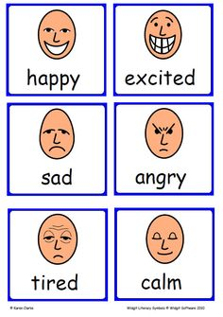
Teaching
Parents & teachers also directly give children information about the nature of various emotions—how they are expressed, why, and when.
Labeling a child’s expression
Teaching new emotion vocabulary
Suggesting strategies and scaffolding
Reading and discussing emotionally laden picture books
Talking about what characters on TV may feel and why
The time spent on and content emphasized through these informal lessons implicitly teaches children about the value of emotions.

Slide 20
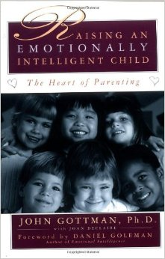
Before we talk about Reactions
John Gottman (1997) Raising an Emotionally Intelligent Child
Examined how parent’s beliefs about and values of emotions impact their parenting style and children’s competencies.

Slide 21
What are your emotional beliefs?
What are the value of emotions?
Do you believe that emotions are inherently good or bad?
To what extent do you feel the need to protect your child from experiencing strong emotions?
Answers to these questions (Warm Up Activity) gives insight in a parent’s metacognitive theory of emotions
Likely informs your reaction to children’s emotions
Emotion Socialization
Being competent & valuing emotions
Modeling emotional expression and regulation
Teaching about emotions
Reacting to children's emotional experiences

Slide 22
Emotion Dismisser
Believes that focusing on negative emotions will only make them bigger/worse.
Undervalue children’s emotional experiences as petty or childish. Trivialized.
Tries to make negative emotions go away when first expressed.
“I don’t want to see him upset, I want him to be happy all the time”
Assume a lot of responsibility for “fixing” their child’s feelings
“where’s that smile?” “don’t be such a baby”
Not insensitive – actually often very sensitive and very protective of child
Children learn to not trust their own emotional experiences and suppress emotional expressions, but still remain physiologically aroused and struggle to self-sooth.

Slide 23
Emotion Disapprover
Similar to Dismissive, however more negative: more critical, lacking empathy, and disapprove of emotion to begin with.
Judges/criticizes child’s expression. Emphasizes conformity, reprimands/punishes for expression (regardless of behavior).
Negative emotions need to be controlled and reflect bad character
Believes children use emotions to manipulate (results in power struggles)
Believes negative emotions are unproductive and waste of time.
Child outcomes are similar to those of Dismissive type but parent-child relationship likely to be more negative overall.

Slide 24
Laissez-Faire
Freely accepts all emotional expression from child.
Believes there’s little that can be done about negative emotions but “ride them out”
Offers comfort to child experiencing negative feelings, but little guidance on behavior
Does not intentionally teach about emotions, doesn’t set limits
Children don’t learn to regulate their feelings, have trouble concentrating, forming/maintaining friendships

Slide 25
Emotion Coach
Is aware of, and values own emotions
Can tolerate spending time with an angry, sad, fearful child without being impatient with the child.
Respects the child’s emotional experience. Does not make light of the child’s negative feeling or try to rescue him/her from emotions.
Doesn’t tell the child how he/she should feel
Sees emotional moments as a time to listen, empathize, label, set limits, and teach problem solving skills.
Children learn to trust feelings and regulate their emotions. High self-esteem, able to form and maintain friendships and solve problems.

Slide 26
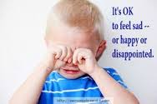
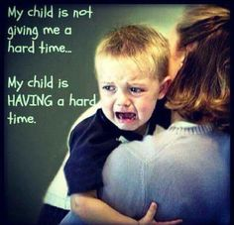
How to be an Emotion Coach
Step One: Label and Validate the Feelings-at-Hand
“Molly, I can see that you are very angry and frustrated. Is there anything else that you are feeling?"
Step Two: Deal with the Bad Behavior (if applicable)
"It is okay to feel angry and frustrated, but it is never okay to throw things or call people mean names”
Step Three: Problem Solve and plan for the future
Child generated solutions if reasonable

Slide 27
Activity 3 – Your Turn to Try
Try out some different strategies and hear from a “child” about what they learn and how they feel after your interactions
Take turns acting out a child’s experience and an adult’s reaction to the following emotional situation. Read the situation and then act out your character’s instructions. Then answer the discussion questions that follow.

Slide 28
Let’s be realistic
But two out of three ain’t bad.
Try to be intentional in how you respond to a majority of your child’s “challenging” emotions.
Positive emotions need coaching too!
Don’t forget to take care of your own emotions.
It won’t always end like this

Slide 29
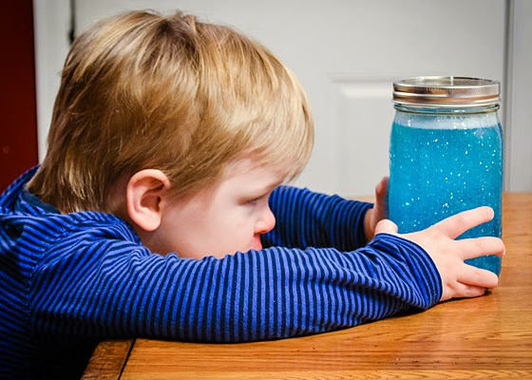
Calm Down Jar can give you and your child a break.
Shake all of your anger, frustration, disappointment, or sadness into this jar. The swirling glitter is like your brain when it’s all wound up.
Watch the glitter settle and think of your mind settling down too.
Take big slow breaths while you watch the glitter calm down.
When you glitter is all at the bottom, how do you feel now?

Slide 30
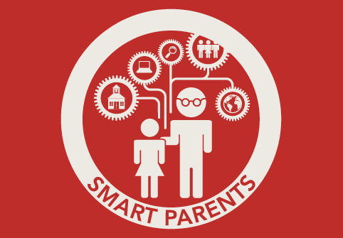
Resources
Setl.psch.uic.edu
@SETLlab
Questions?
http://www.parenttoolkit.com/

